Slide 1
The real estate information system managed by Agenzia delle Entrate
The evolution of cartographic system
for the land management
Roma, November 20th 2014
Eng. Flavio Ferrante
Central Directorate Cadastre and Cartography
Italian Revenue Agency
Agenzia delle Entrate – Largo Leopardi, 5 00185 – Roma

Slide 2
Table of contents
Overview on the cadastral cartography historic evolution
The current cadastre cartographic system with a focus on the automatic system updating
The Interoperability of the cadastral cartography: The trasformation of cadastral cartography in the national and global coordinate systems
The INSPIRE Directive implementation
The cadastre cartographic system for land management

Slide 3
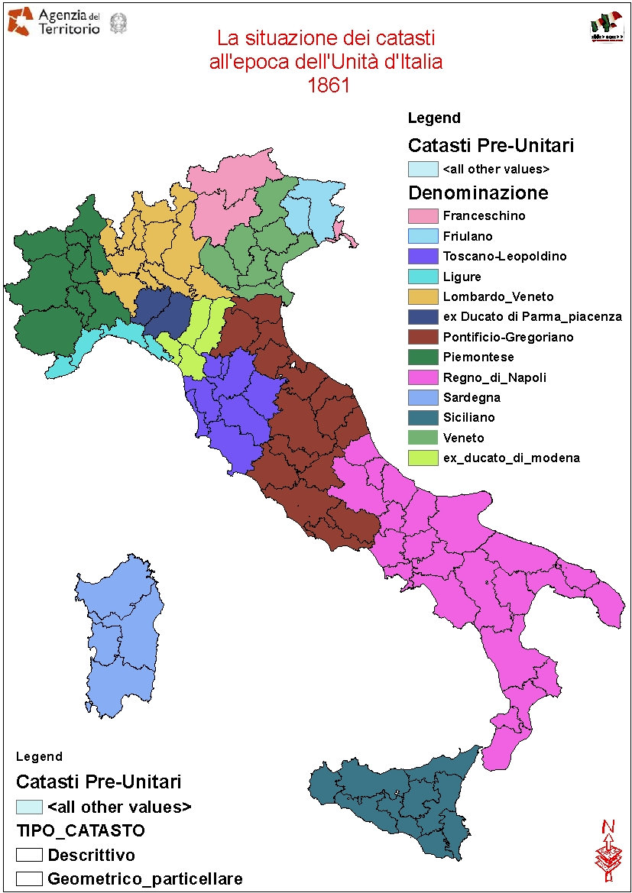

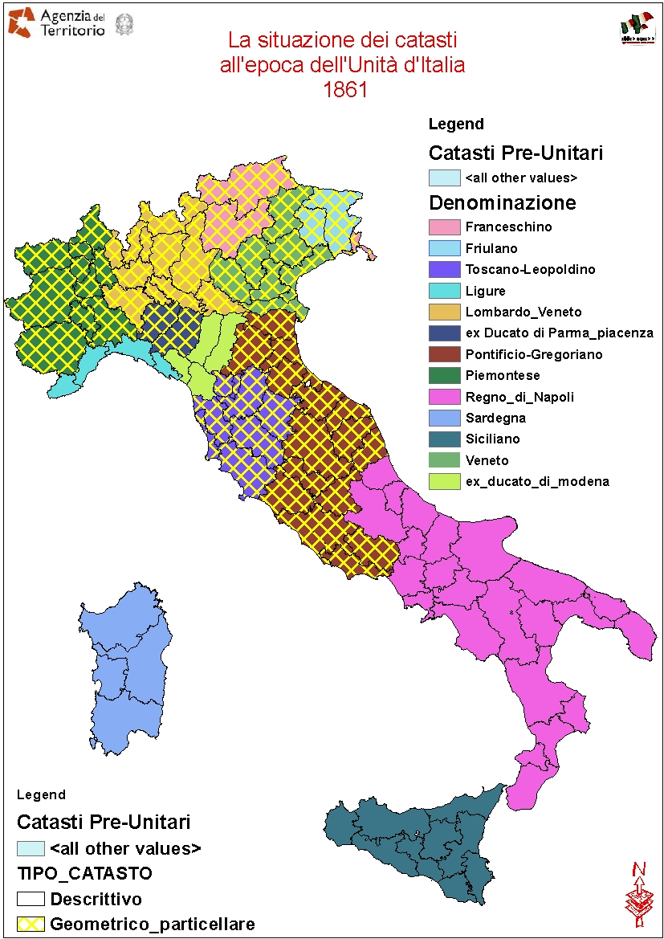

The situation of the Cadastres at the time of the unification of Italy
The situation of the Cadastres
at the time of the unification of Italy
The situation of the Cadastres
at the time of the unification of Italy
22 different types of Cadastral systems
  based on geometrical data
  14 based on descriptive data

Slide 4
Law 1st march 1886 n.3682 for the constitution of the Italian Cadastre
A CLEAR VISION OF A MODERN CADASTRE
Art. 1 (Purposes)
The State will arrange for the creation, in all the Kingdom, of an homogeneous, geometric and parcel based Cadastre, by measurements and assessment, in order to:
- register the land properties and their changes
- equalize land taxation

Slide 5
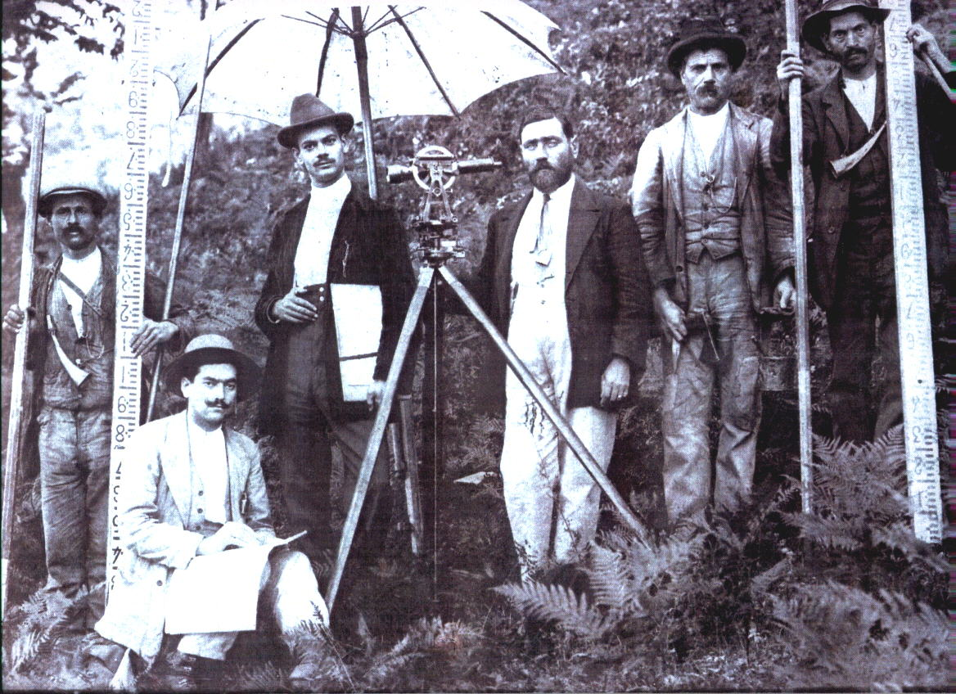
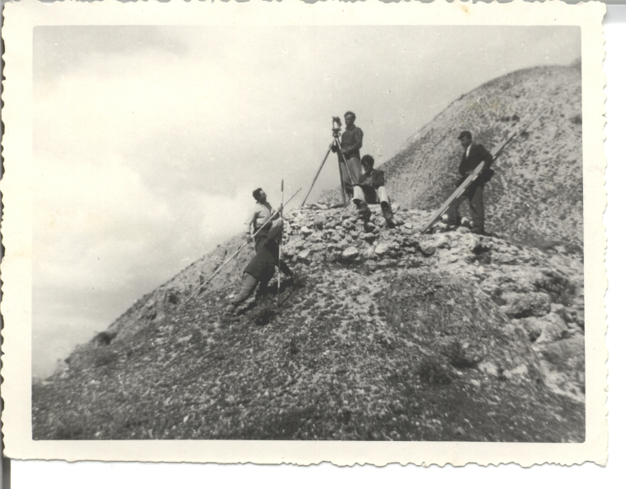
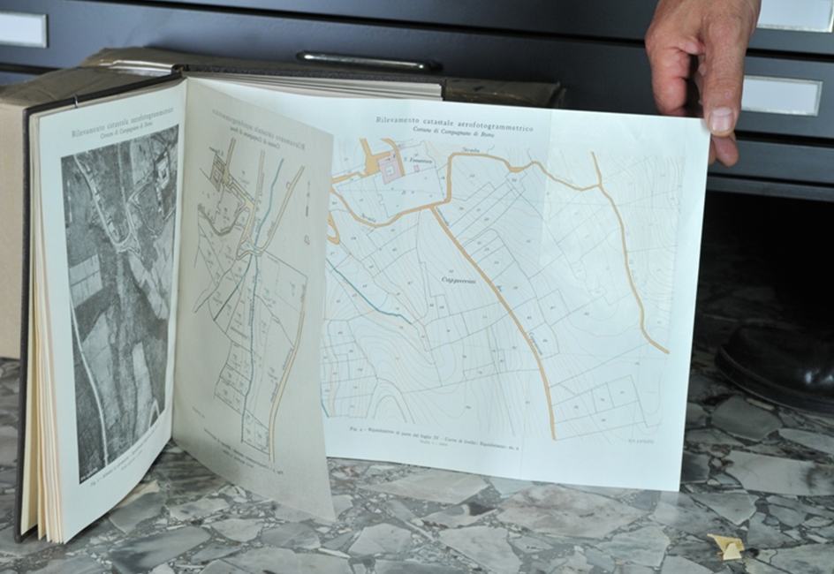

THE EFFORT REQUIRED TO COMPLETE THE ITALIAN LAND CADASTRE
The cadastral works necessary to complete the Land Cadastre for all the national territory required about 70 years (conclusion in 1956),
more than the 20 years supposed at the beginning.
CADASTRAL SURVEYING TECNIQUES ALWAYS ABREAST OF THE TIMES
In 1934 the Italian Cadastre carried out
one of the first world experiences in using the
aerophotogrammetric method
for the creation of cadastral maps
Cadastral map of Campagnano Romano
realized by the Cadastre with the
aerophotogrammetric method in 1934

Slide 6
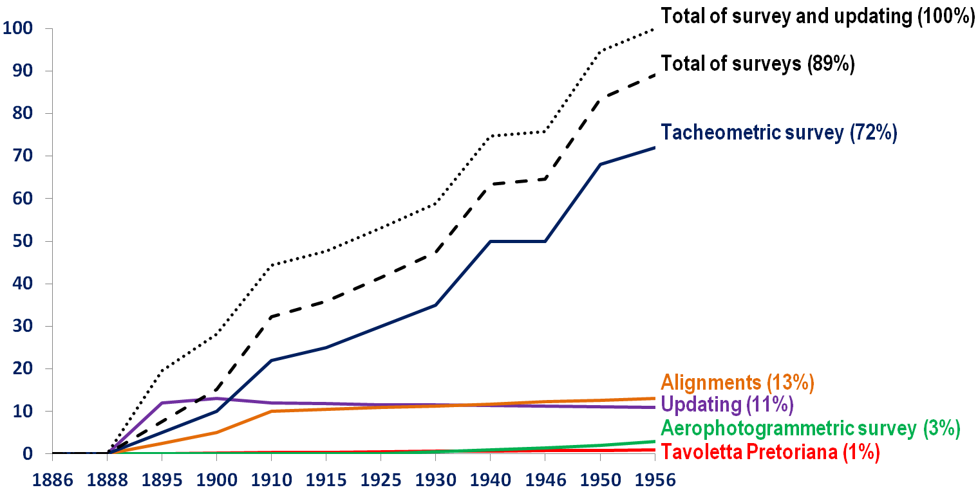
Survey methods used for the establishment of the cadastral map

Slide 7
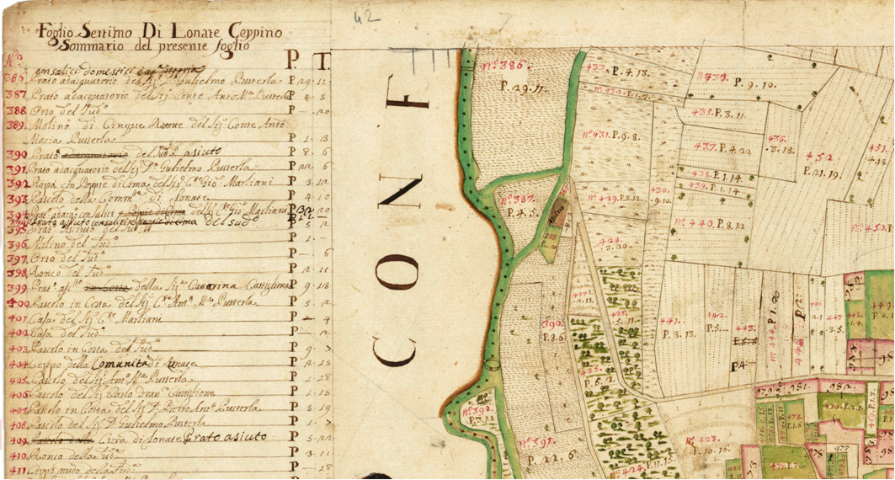
Example of
PRE-UNIFICATION GEOMETRIC PARCEL BASED CADASTRE
CADASTRE under Maria Theresa of Austria
Municipality of Lonate Ceppino (Varese)
Cadastral map sheet number 7 (1722)
“SOMMARIONE”
INDEX
Scale 1 : 5.000
Parcel ID
Crop and owner
description
Size
Cadastral map (parcel based)

Slide 8
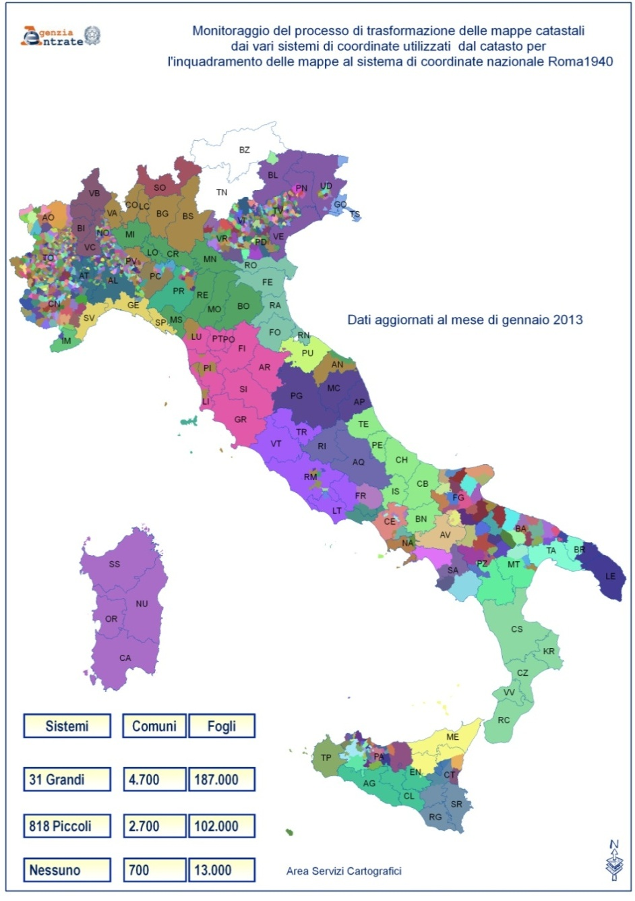
The coordinate systems used In the Italian Cadastre
More than 800 different
Coordinate Systems
The coordinate systems
of the cadastral cartography
Systems
Municipalities
Sheets
32 large extension
4.700
187.000
817 small extension
2.700
102.000
Cassini-Soldner
Projection System
None
700
13.000

Slide 9
Table of contents
Overview on the cadastral cartography historic evolution
The current cadastre cartographic system with a focus on the automatic system updating
The Interoperability of the cadastral cartography: The trasformation of cadastral cartography in the national and global coordinate systems
The INSPIRE Directive implementation
The cadastre cartographic system for land management

Slide 10
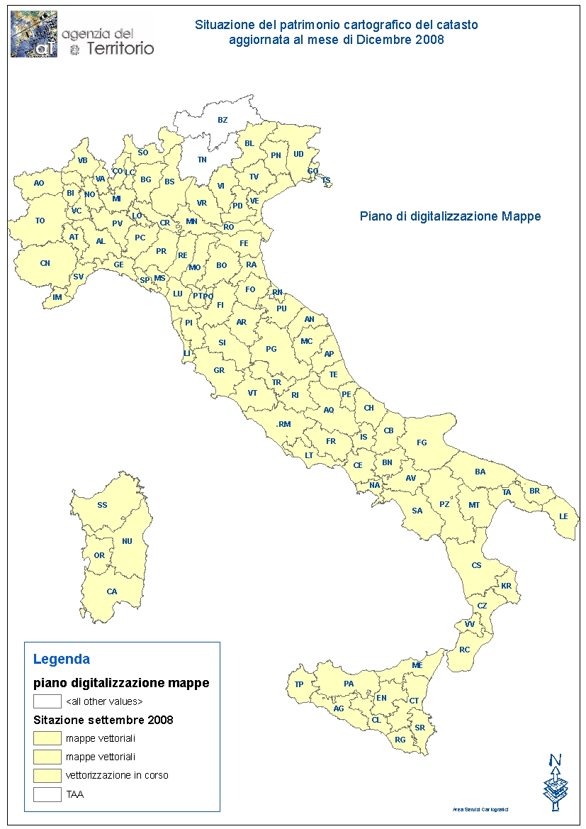
The geotopocartographic patrimony of the cadastre
300.000 map sheets
12 million updating acts
stored in digital format
600.000 updating deeds
registered every year managing
about 2 million parcels
7 million reference points
80 million parcels
  65 million land parcels
  15 million building parcels
26 million land owners
State of the cartographic patrimony of the
Agenzia delle Entrate updating: october 2009
344.000 cartographic files
278.000 map sheets
20.000 annexes
46.000 developments

Slide 11
The current cartographical system of the cadastre and its strong points
It is complete and homogeneous
all over the nation
It is totally managed in
vector format
It is based on high-scale maps
  240.000 maps scale 1:2000
  30.000 maps scale 1:1000
  30.000 maps scala 1:4000
It is directly related to the administrative census DB of the Land Cadastre through a unique identifier: the parcel number
It’s available in every national and global (WGS84-ETRF2000) coordinate systems
It is integrated with a high resolution ortho imagery and National road maps

Slide 12
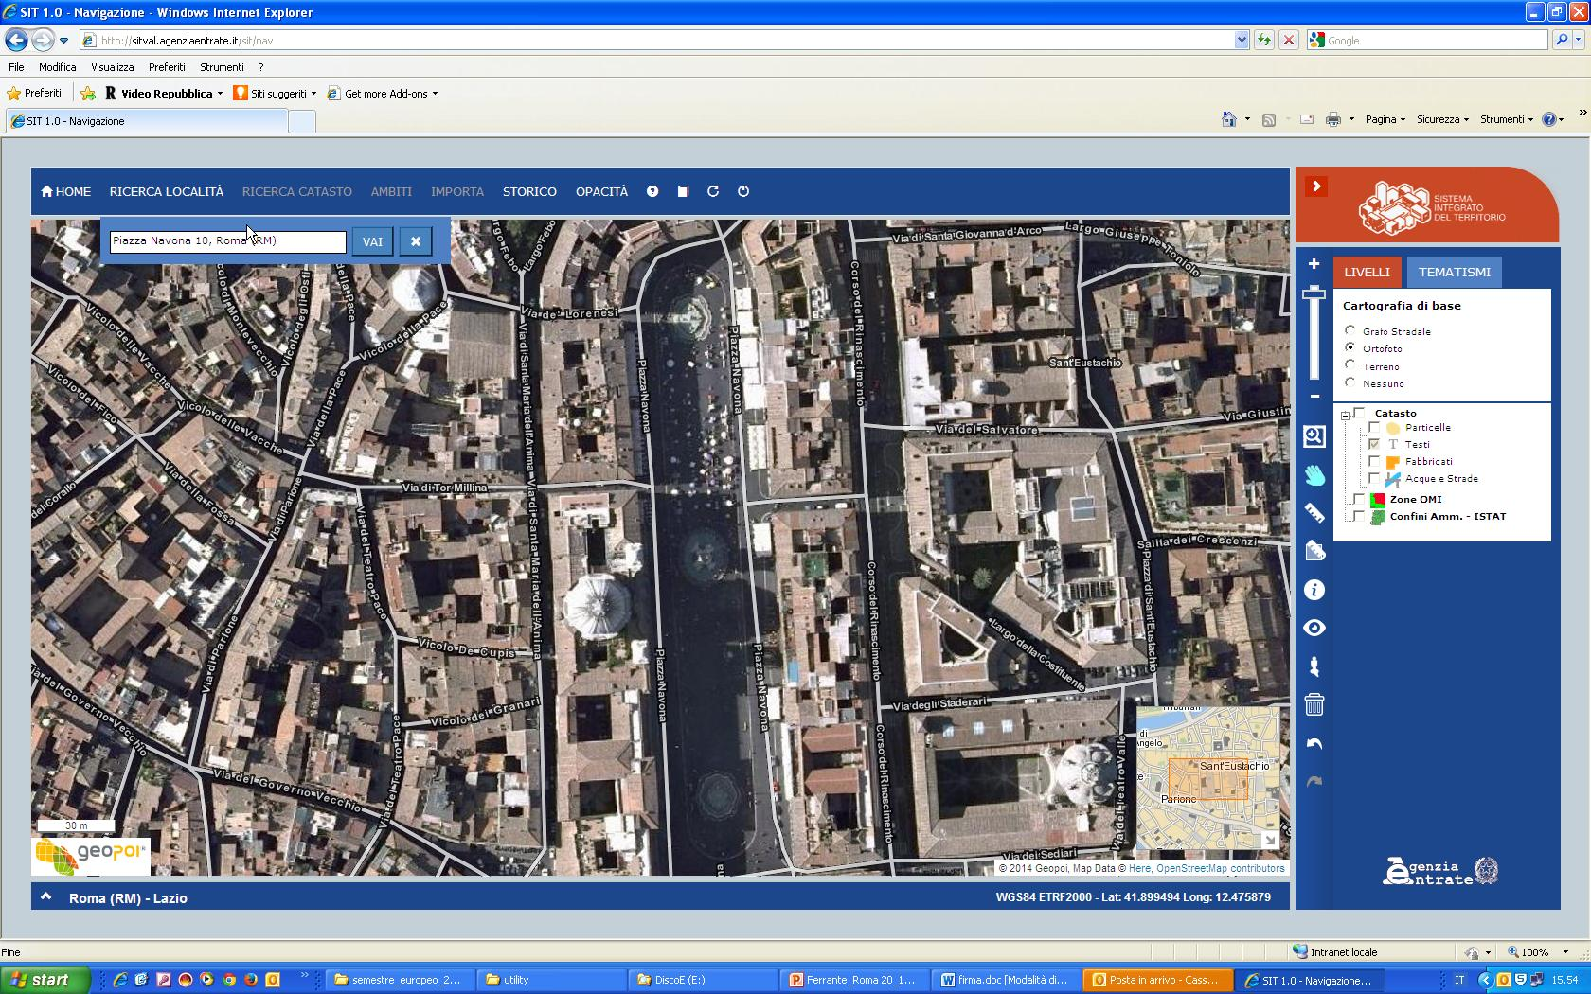
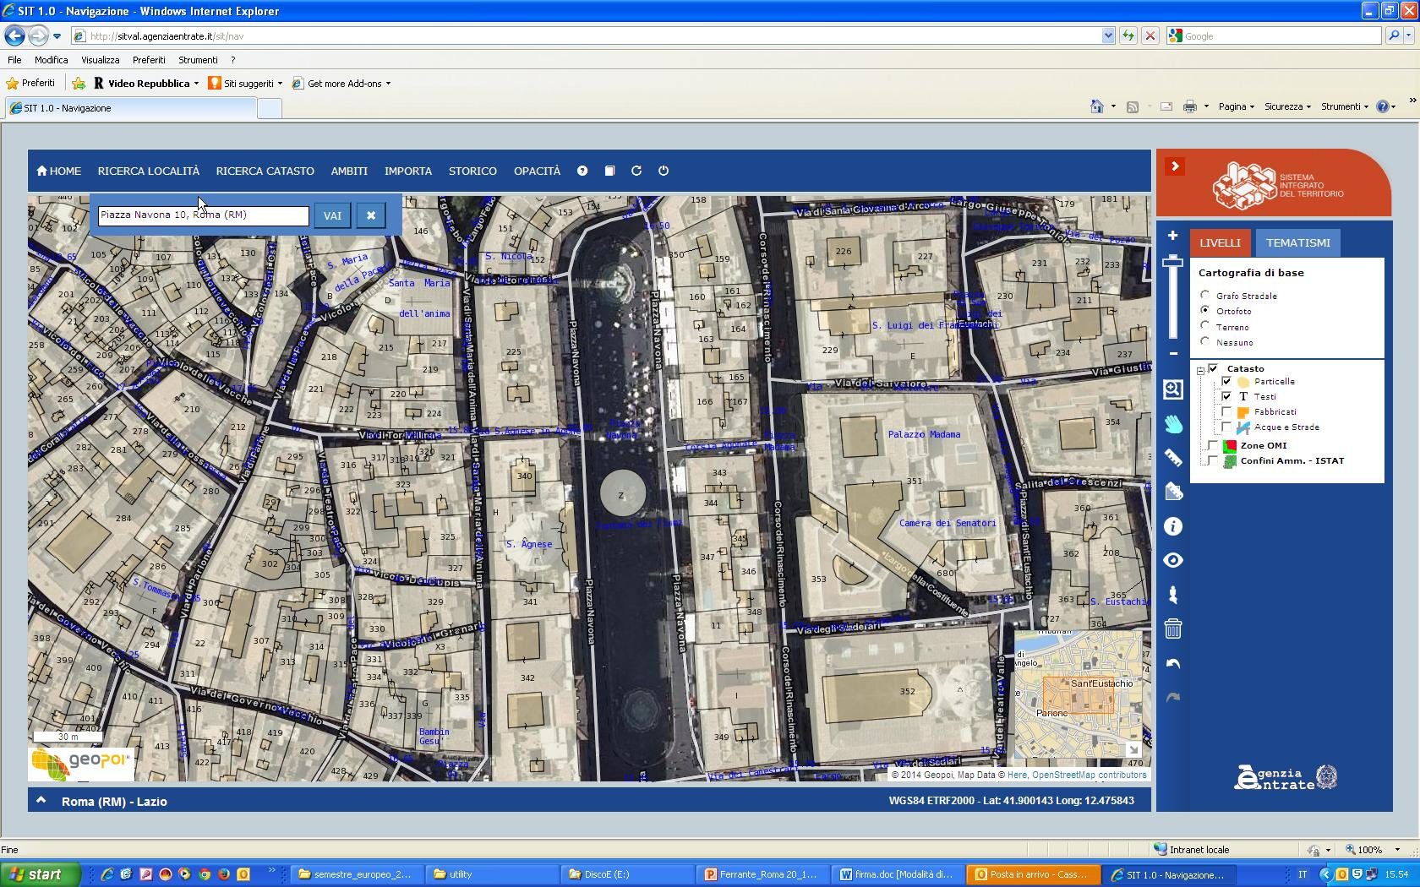
S.I.T. - Integrated Territory System

Slide 13
The current cartographical system of the cadastre and its strong points
It is complete and homogeneous
all over the nation
It is totally managed in
vector format
It is based on high-scale maps
  240.000 maps scale 1:2000
  30.000 maps scale 1:1000
  30.000 maps scala 1:4000
It is directly related to the administrative census DB of the Land Cadastre through a unique identifier: the parcel number
It’s available in every national and global (WGS84-ETRF2000 ) coordinate systems
It is integrated with a high resolution ortho imagery and National road maps
It is updated automatically and in real time by professionals through an infrastructure and an organizational concept based on its software application Pregeo 10

Slide 14
The new updating system
Evolution of the updating process with PREGEO software application
1988
2003
2006
2010
PREGEO
PREGEO 8
PREGEO 9
PREGEO 10
Circular n° 2/’88
Software applications for the cadastre updating
Cartography digital management
Updating acts web trasmission
Automatic updating
WEGIS
SISTER
Use of satellite technology
GNSS
Pregeo_10

Slide 15
Some considerations about the new updating system
The cadastral updating system involves external surveyors in updating the cadastral data base directly from their own offices
The checks are completely transparent because they are performed by a software application based on shared rules
By applying the new updating map the Cadastre and the external surveyors have taken a new step in administrative culture
The new updating system of the Cadastre represents an organization model to be proposed to other departments of the Public Administrations

Slide 16
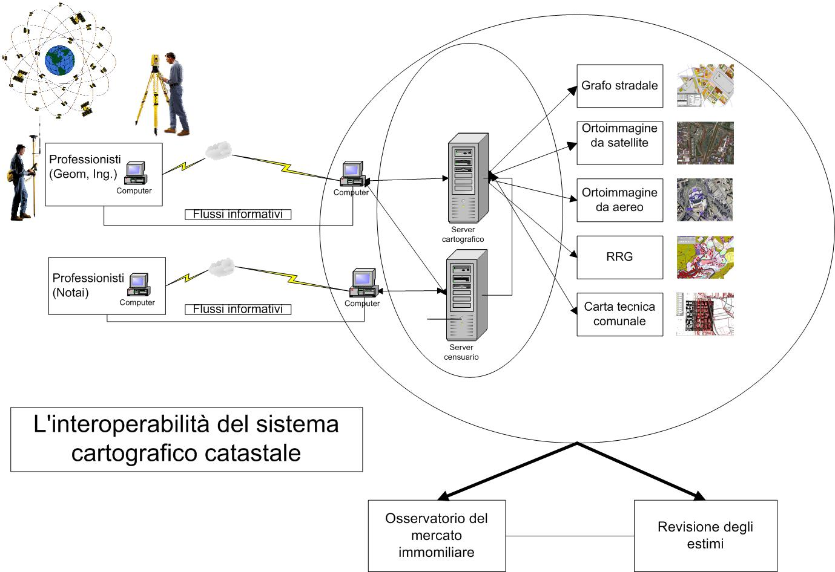
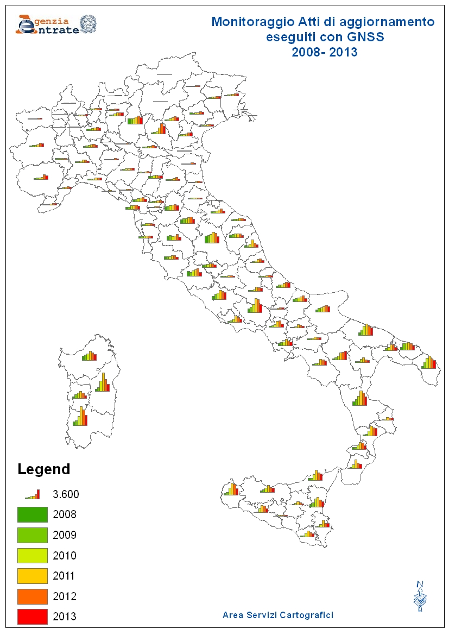
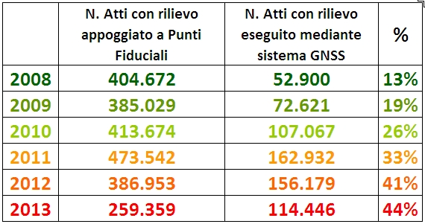
The Cadastre updating by GNSS technology (Global Navigation Satellite System)
Updating
System
Monitoring
Number of Surveys by GNSS
Number
Of Surveys
Number of Surveys by GNSS

Slide 17
Table of contents
Overview on the cadastral cartography historic evolution
The current cadastre cartographic system with a focus on the automatic system updating
The Interoperability of the cadastral cartography: The trasformation of cadastral cartography in the national and global coordinate systems
The INSPIRE Directive implementation
The cadastre cartographic system for land management

Slide 18
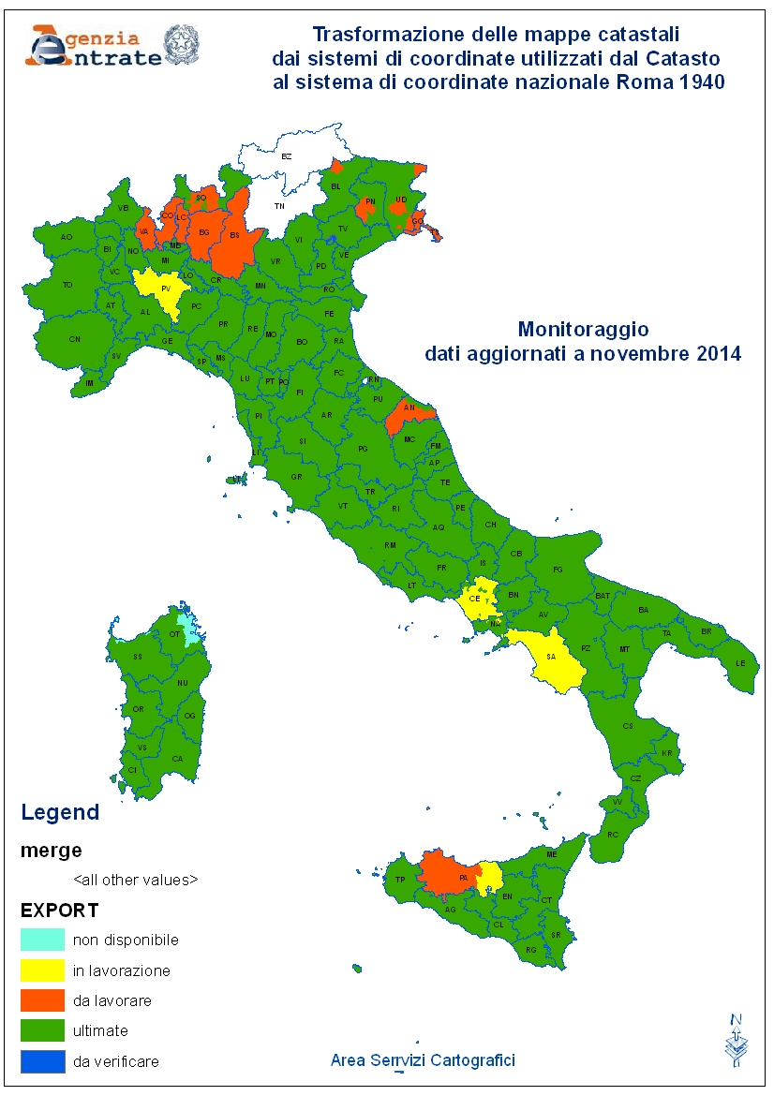
Unification of the National Coordinate Systems (Roma1940 Gauss-Boaga)
More than 800 different
Coordinate Systems
Unification of the National
Coordinate Systems
Roma1940
Cassini-Soldner
Projection System

Slide 19

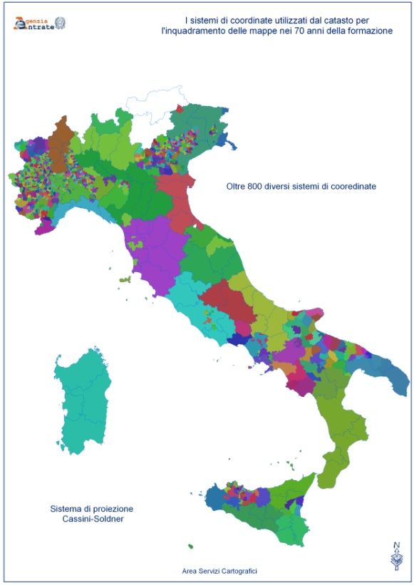
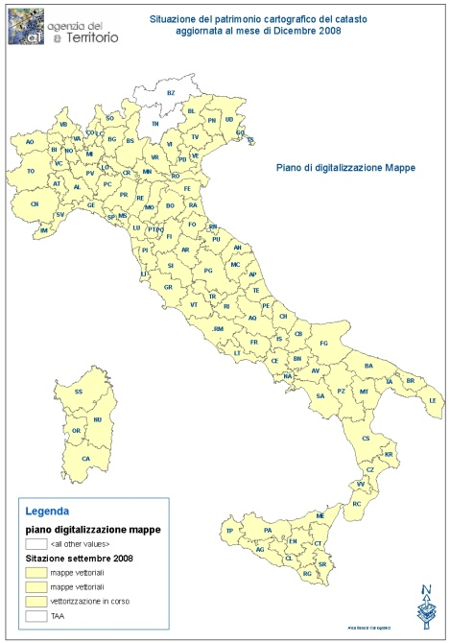
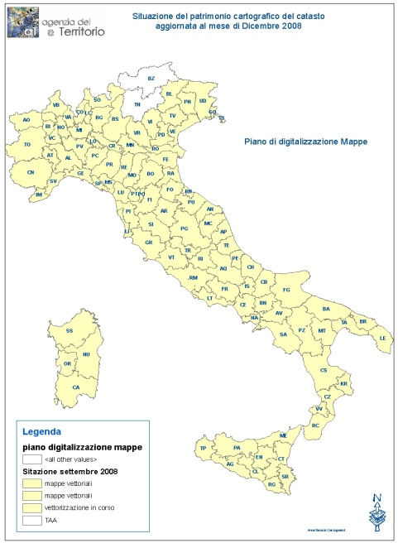
INSPIRE directive
D.P.C.M. 10 november 2011
M
I
L
I
T
A
R
Y
G
E
O
G
R
A
P
H
I
C
I
N
S
T
I
T
U
T
E
T
R
A
N
S
F
O
R
M
A
T
I
O
N
M
A
T
R
I
x
Scientific method
Sub-metric accuracy
90%ready through 2014
Scientific method
Sub-metric accuracy
90%ready through 2014
Unique National Coordinate System -Roma40-Gauss-Boaga
Global coordinate system
WGS84 - ETRF2000
Effects for:
P.A. Departments
Cadastral cartography transformed in ETRF2000 Coordinate System
External surveyors :
Map extracts in ETRF2000
Analog method
Metric accuracy
100% ready
Analog method
Metric accuracy
100% ready

Slide 20
Table of contents
Overview on the cadastral cartography historic evolution
The current cadastre cartographic system with a focus on the automatic system updating
The Interoperability of the cadastral cartography: The trasformation of cadastral cartography in the national and global coordinate systems
The INSPIRE Directive implementation
The cadastre cartographic system for land management

Slide 21
The usability of the cadastral data and the implentation of INSPIRE Directive
Access
Metadata
RNDT
(National Repository of Territorial Data)
Connection
AdE web portal
(december 2014)
Data
Cartography
(parcel)
Agency web portal
(PF-monographs)
Sister - Fisco_online
(cadastral interrogations, map extracts, vector maps)
Web portal for Municipalities
Interchange system
INSPIRE SERVICES (Data view, discovery and download)
(december 2014)

Slide 22
Table of contents
Overview on the cadastral cartography historic evolution
The current cadastre cartographic system with a focus on the automatic system updating
The Interoperability of the cadastral cartography: The trasformation of cadastral cartography in the national and global coordinate systems
The INSPIRE Directive implementation
The cadastre cartographic system for land management

Slide 23
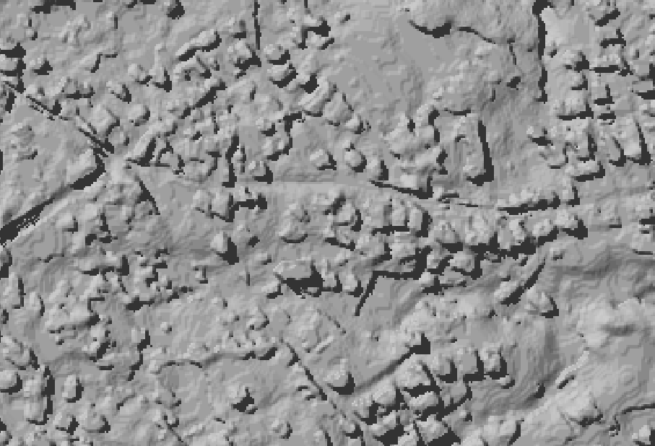
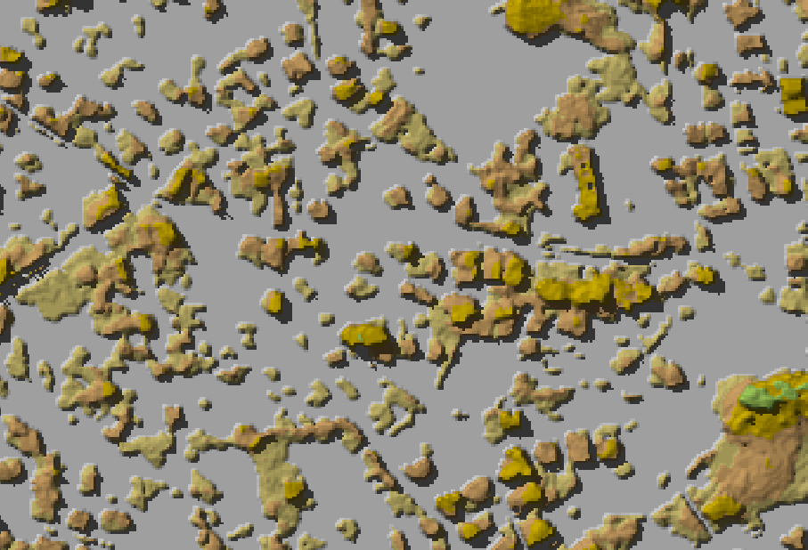
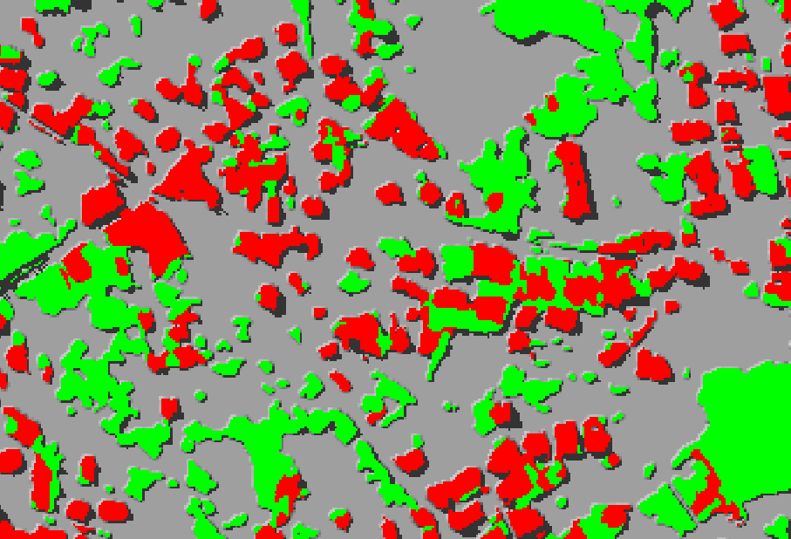
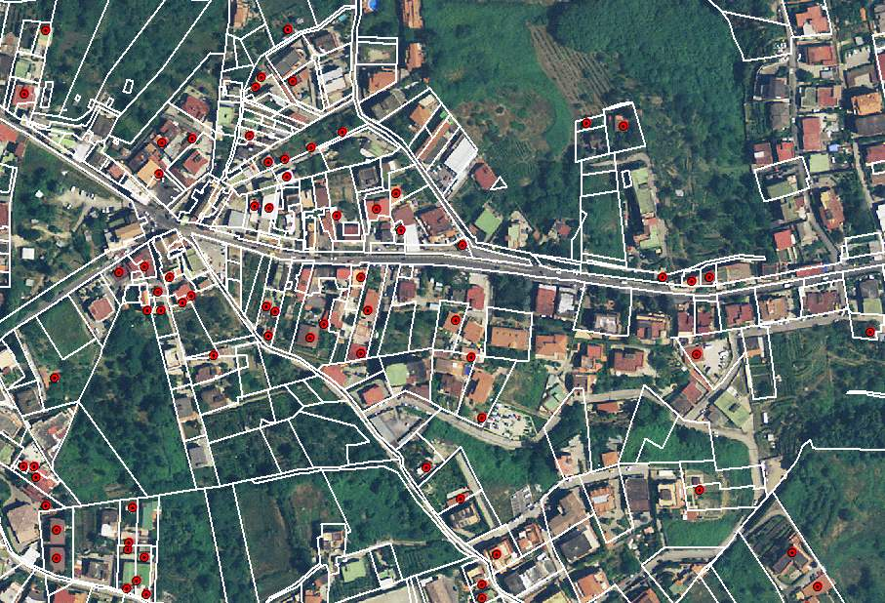
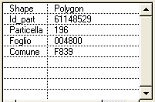
The cadastre for the fight against tax evasion
Detection of Buildings not registered in cadastre
Elevation Surface Model (ESM)
Classification of objects aboveground based on height
The Law 78/2010,
Gives to the Agenzia delle Entrate the periodic monitoring of national territory for detecting other buildings not registered in cadastre
Integration of the cadastral cartography with DEM, ESM, Infrared Images,
and ortho imagery, for the automatic identification of buildings not declared to the cadastre
From 2007 to 2010
more than 2.000.000 buildings not declared to the Italian cadastre have been automatically Identified
Classification of buildings (red) and vegetation (green) with infrared images
Automatic identification of buildings not present on the cadastral map

Slide 24
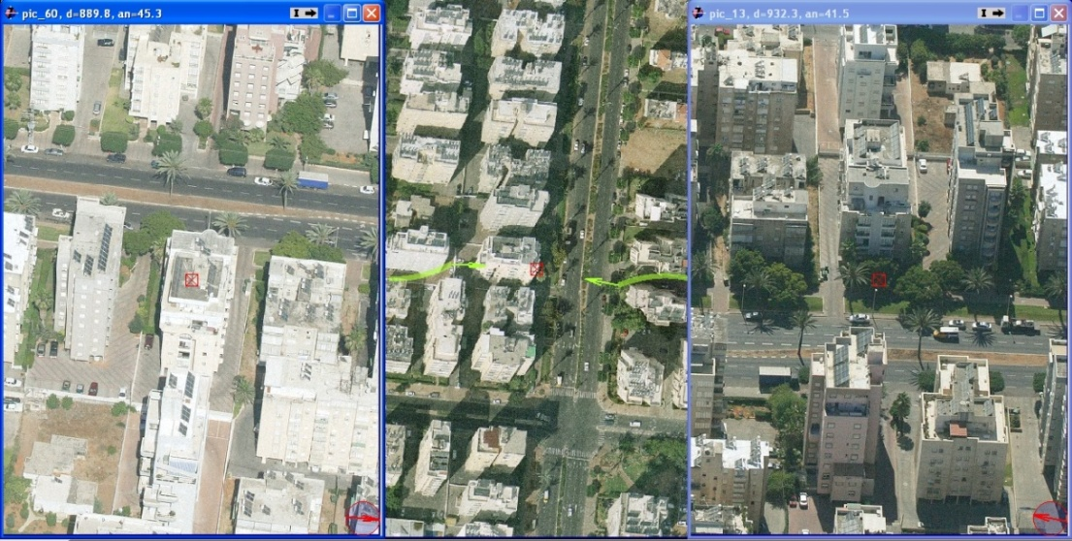

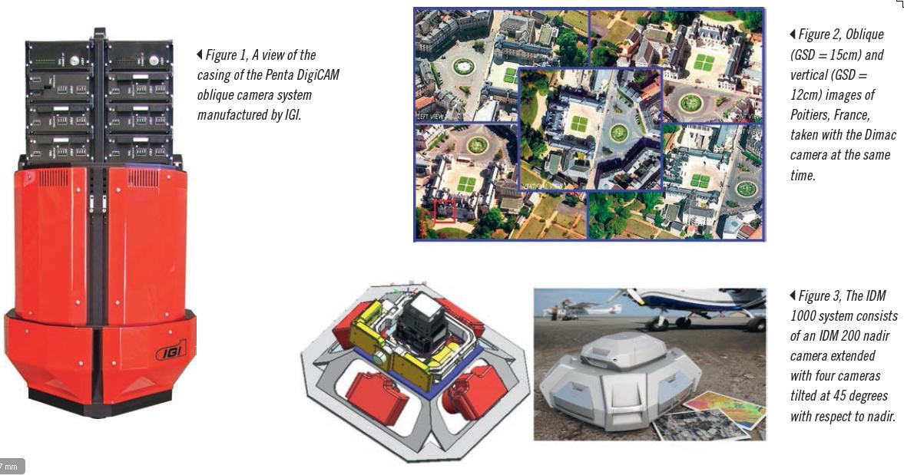
Aerial imagery acquisition by oblique camera system
Aerial Imagery

Slide 25
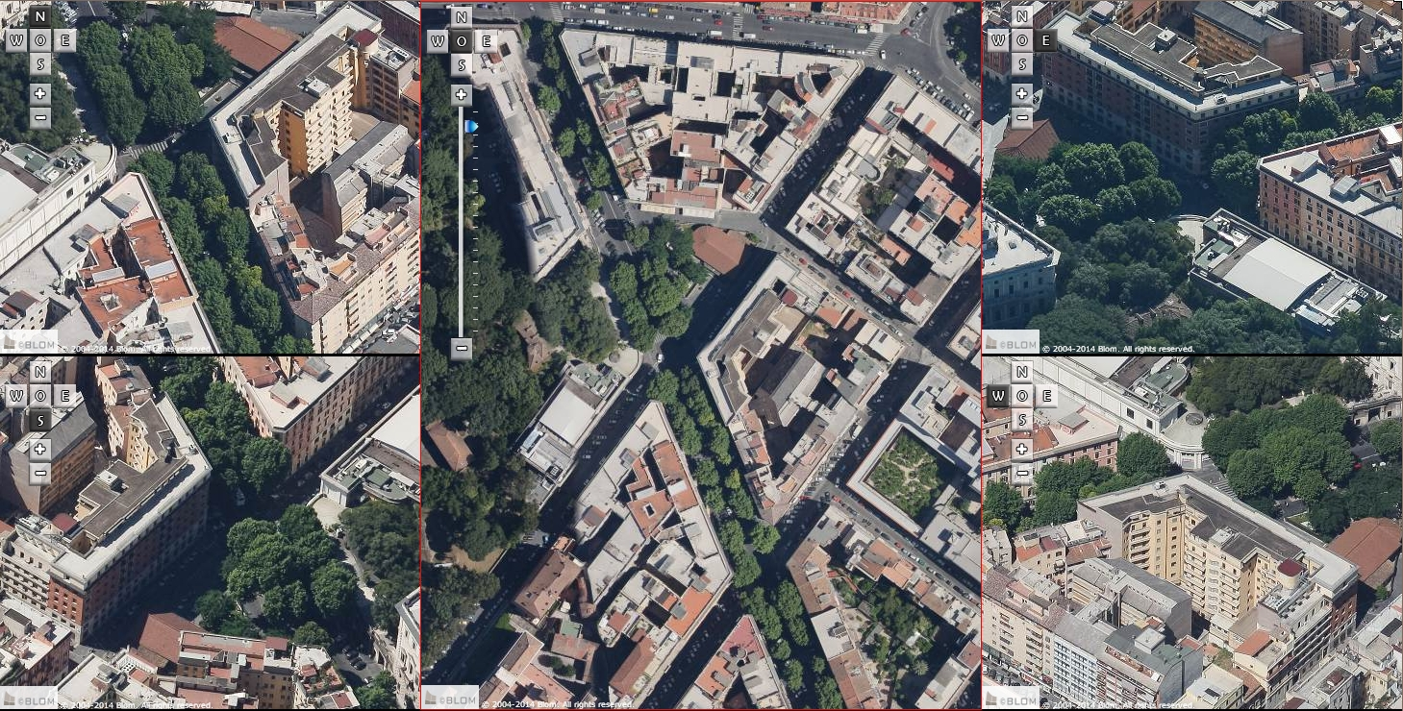
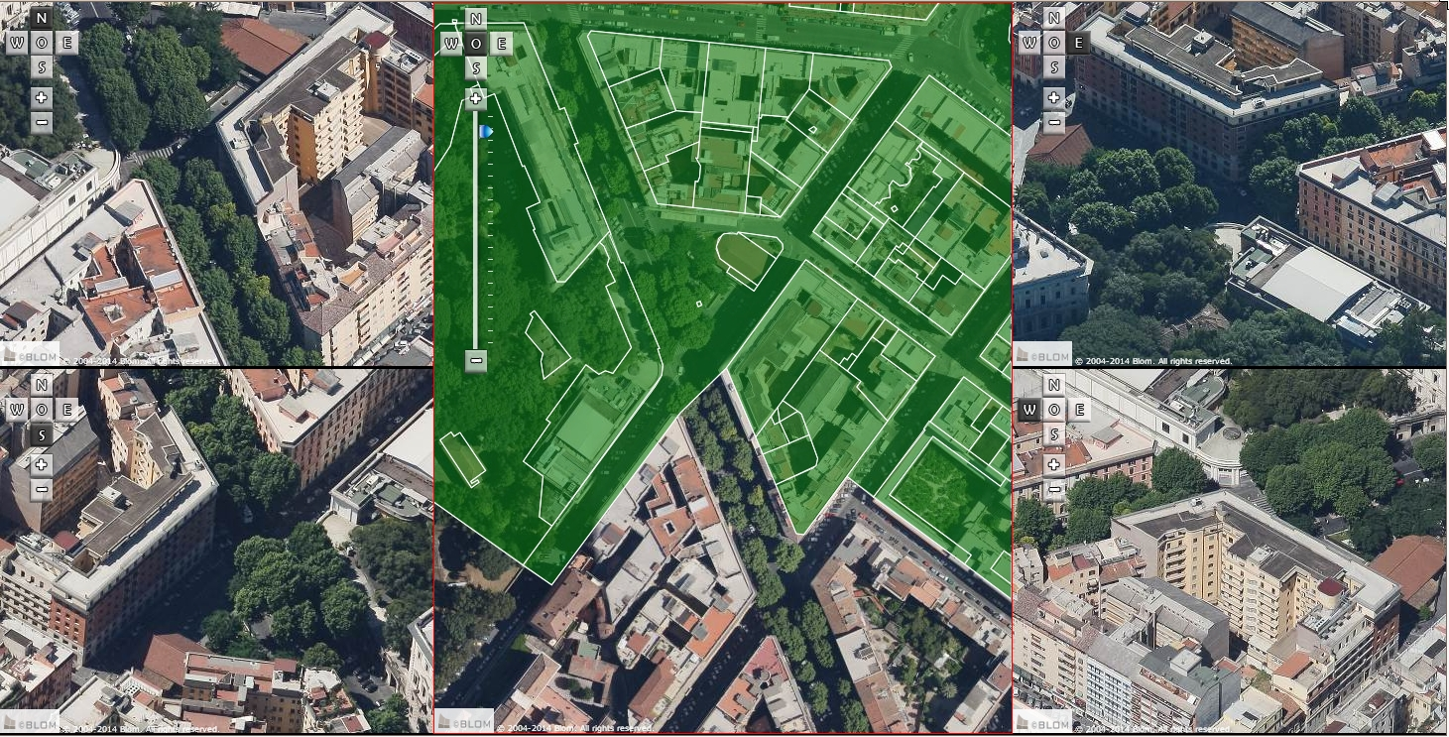
Integration of the cadastral Map with orthoimagery and oblique images for the survey of the exterior features of buildings to support the Cadastre Review
Fg.495
Paticella 234

Slide 26
The real estate information system managed by Agenzia delle Entrate
The evolution of cartographic system
for the land management
Roma, November 20th 2014
  Thanks for Your attention
Eng. Flavio Ferrante
Central Directorate Cadastre and Cartography
Italian Revenue Agency
Agenzia delle Entrate – Largo Leopardi, 5 00185 – Roma

